Slide 1
Strengthening the Colorado Educator Workforce Pipeline
Analysis and Action Planning Facilitation Slides

Slide 2
Module 1:
Landscape Analysis

Slide 3
Welcome and Introductions
Notes:
Facilitation note: Welcome audience and segue to facilitator introductions on next slide. If desired, individual participant introductions can also be included.

Slide 4
Facilitators
[Insert name(s) of facilitator(s)]
Notes:
Facilitation note: Update this slide with the name(s) of your facilitator(s). Introduce yourself including your background and experience related to the educator workforce.

Slide 5
Today’s Objectives
Introduce teams and build community
Understand the importance of addressing educator shortages and diversity in Colorado
Engage in a landscape analysis to better understand existing resources, policies, and initiatives related to strengthening and diversifying the educator workforce
Notes:
By the end of today’s module, you will understand the importance of addressing educator shortages and diversity in Colorado. You will engage in a landscape analysis with your team to better understand existing resources, policies, and initiatives related to strengthening and diversifying the educator workforce.

Slide 6
Norms for Discussion
Be present and attentive.
Share the air.
Respect what is shared.
Notes:
Facilitation note: Update with any existing norms for your team.
For our work to be productive and positive, we have some norms for our discussion together. First, we ask that everyone be present and attentive. Please minimize other distractions so you can be fully present and participate in the session. The next norm is to share the air. Please contribute freely to the discussion while also providing time for others to do so. The works benefits from hearing from all your diverse perspectives as we explore the data. Finally, we ask that everyone respect what is shared. Are there any other norms you would like to add?

Slide 7
Strengthening the Colorado Educator Workforce Pipeline Modules
Module 1: Landscape Analysis
Module 2: Data Analysis
Module 3: Root Cause Analysis
Module 4: Select Strategies
Module 5: Action Planning
Notes:
This session if the first of a five modules designed to help district or regional teams use data to identify community specific strategies to strengthen and diversify the educator workforce. In the first module, teams will reflect on existing and past efforts to prepare, recruit, and retain diverse educators by conducting a landscape analysis. The second module guides teams in analyzing local data using a geographic information system map. In the third module, teams reflect on the data findings from the previous module and determine the root causes of their educator workforce challenges. For the fourth module, teams will explore new and existing strategies to address the root causes identified and determine which will be the best fit for their local needs and capacity. For the final module, teams will develop an action plan to implement the identified strategies to strengthen and diversify the educator workforce.

Slide 8
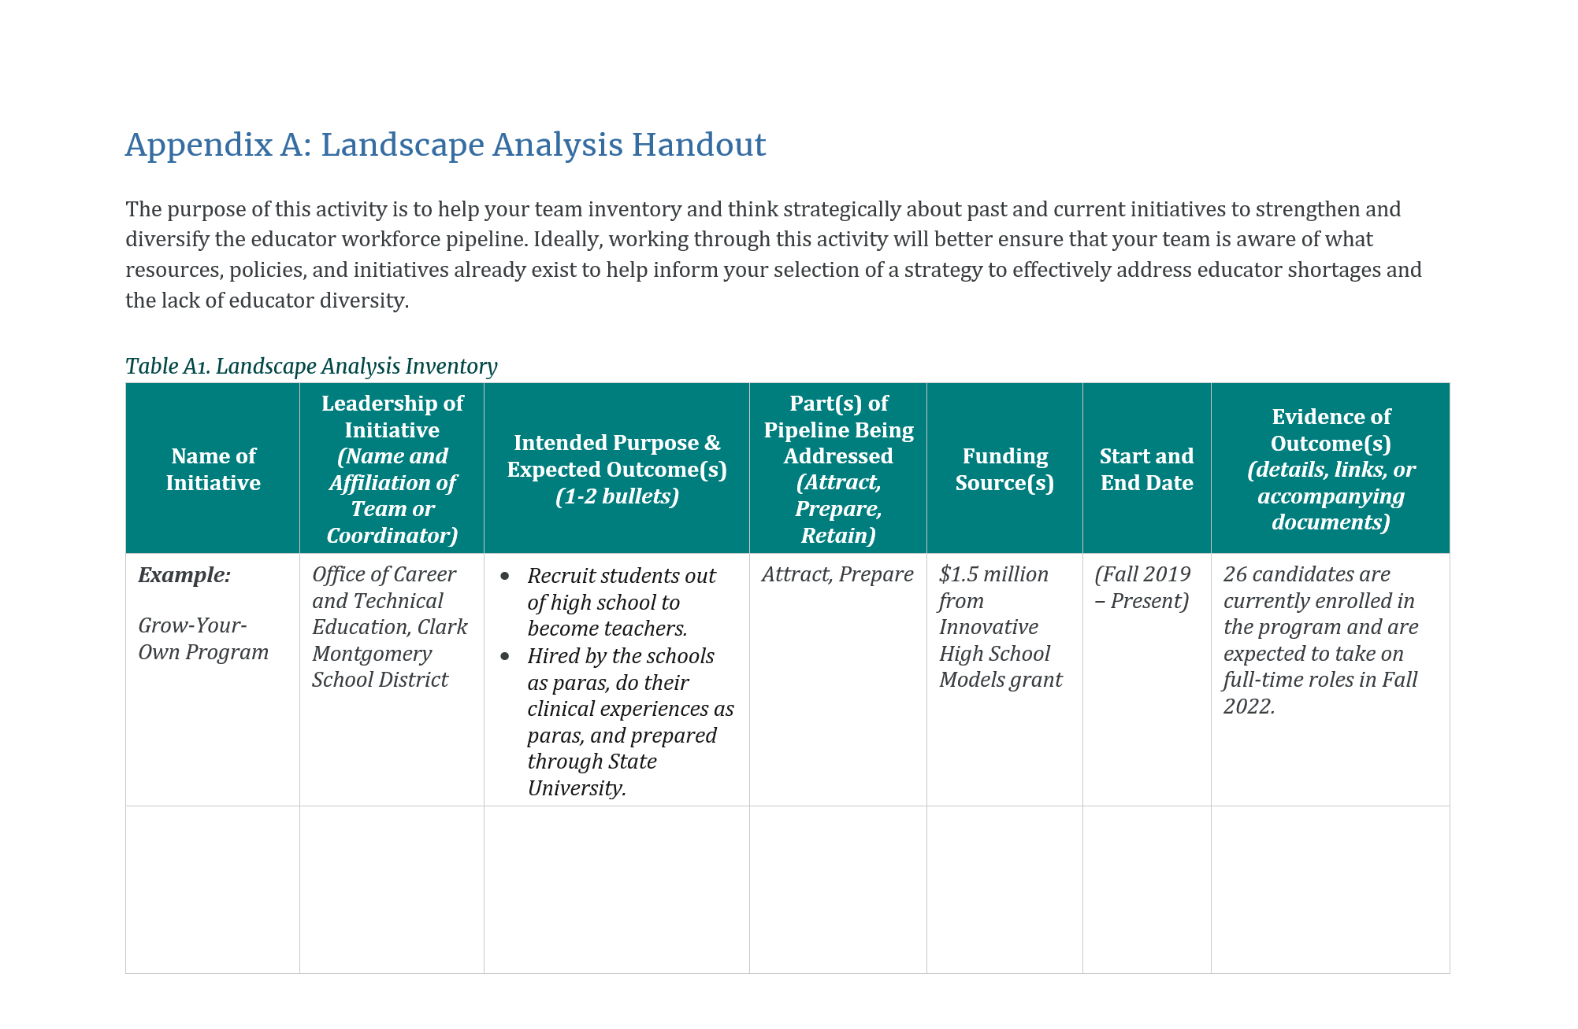
Session Materials
Notes:
Facilitation note: Please see Table 1 in Module 1 in the Facilitator’s Guide for an outline of all the materials needed for the session for both in-person and virtual facilitation. Update this slide to reflect the specific materials depending on the mode of facilitation. The handout for the session can be found in Appendix A of the facilitator’s guide.
For this session, we’ll use the module handout to help guide our work together.

Slide 9

Team Building Exercise
For your teams, you will develop a:
  Team Name
  Logo/Mascot
  Vision Statement
Notes:
Facilitation note: Refer to pages 2-5 in the Facilitator’s Guide for further instructions on how to facilitate this this activity virtually or in-person.
For your team, brainstorm a team name, draw a logo or mascot for your team, and draft the visions statement for the work of your team.

Slide 10
Addressing Educator Shortages and Diversity in Colorado
The Why
Notes:
Next, we’re going to discuss why it is important to focus on addressing educator shortages and diversity in Colorado.

Slide 11

The Case for More Diverse Teachers
(NPR, 2017)
Notes:
Facilitation note: The video in the slide is available at https://www.youtube.com/watch?v=58E8wk959Rw&t=1s. You may request participants watch the video as pre-work to the session.

Slide 12
Colorado Educator Shortage Context
 | 2020–2021​ | 2021–2022 | 2022–2023
Teaching positions filled by shortage mechanism | 13.0% | 19.7% | 17.9%
Unfilled teaching positions​ | 3.4% | 7.7% | 8.7%
(Colorado Department of Education, 2024)
Notes:
Over the last three years, Colorado has seen an increased unfilled teaching positions. To help address this challenge, there has also been an increase in schools and district filling vacancies using a shortage mechanism such as long-term substitute teacher, alternative licensed teacher, emergency licensed teacher, or a retired teacher.
Note: Colorado teacher shortage data is updated annually, and reports are available at: https://www.cde.state.co.us/educatortalent/edshortage-surveyresults

Slide 13
Colorado Educator Workforce Diversity Context
BIPOC: Black, Indigenous, and People of Color
(Colorado Department of Education, 2024)
Notes:
The diversity of Colorado teachers does not align with the racial diversity of its students. 85.2% of Colorado teachers are white whereas nearly 50 percent of students in Colorado are Black, indigenous, and/or people of color.
Note: Colorado teacher shortage data is updated annually, and reports are available at: https://www.cde.state.co.us/cdereval/staffcurrent

Slide 14
Teacher Shortages and Teacher Diversity
Teachers are the most important within-school factor driving student achievement.
Diverse teachers improve outcomes for all students, particularly students of color.
Addressing shortages AND diversity can ensure that all students, particularly students of color, have access to effective instruction.
(Egalite et al., 2015; Gershenson et al., 2018; Gershenson et al., 2015; Grissom & Redding, 2016; Lindsay & Hart, 2017)
Notes:
A diverse educator workforce is integral to providing effective instruction. Diverse teachers improve academic achievement, graduation rates, college enrollment, reduce absences and suspensions, and other measures of success for all students, particularly students of color. So, addressing shortages with a specific focus on the shortage of teachers of color is an important strategy for ensuring that all students, particularly students of color, have access to effective instruction.

Slide 15



Shortage is a School- and Subject-Level Problem
Broad analysis:
District X has one chemistry teacher for every 400 students
More accurate analysis:
One qualified chemistry teacher for every 2,000 students in high-need schools
One chemistry teacher for every
100 students in affluent schools
15
Notes:
Disaggregating data to the school-level shows that educator shortages is a school and subject level challenges. Rural schools and schools that serve marginalized and minoritized students experience greater educator shortages. Shortages may also be concentrated in specific subject areas that hard to fill such special education, STEM, and CTE. However, policymakers may miss these trends if they only look at district or regional-level data analysis and do not disaggregate data to the school-level. The example on the slide highlights how looking at data at the school-level can highlight subject and school-level shortages for high-need schools.

Slide 16
Identifying Shortage and Diversity Gaps Within the Pipeline
(Center on Great Teachers and Leaders, 2020, p. 3​)
Notes:
To address educator shortages and diversity gaps, district and schools employ a variety of strategies along the Talent Development Framework from attract, prepare, to develop, support, and retain. The root causes to educator shortages and diversity gaps can vary across different communities. For example, rural communities may have greater challenges with recruiting educators due to a lack of access of nearby educator preparation programs whereas an urban school may struggle to retain diverse educators due to poor teaching and learning conditions. It will be critical for districts, region, and community partners examine data to determine the appropriate strategies to strengthen their educator workforce.

Slide 17
Reflections on Your Experience
To what extent do the data and evidence shared reflect your experience with educator shortages and diversity gaps?
What connections do you see in your work with addressing educator shortages and diversifying the educator workforce?
Notes:
Facilitation note: Refer to pages 4-5 in the facilitator’s guide for further guidance on how to facilitate this discussion virtually or in-person.
With a partners, reflect and discuss the questions on the slide.

Slide 18
Landscape Analysis
Notes:
Next, we will review the instructions for completing the landscape analysis activity.

Slide 19
Purpose of Landscape Analysis
Allows teams to think critically about past and present initiatives that are used to address educator shortages and diversity
Provides a starting point for teams to brainstorm additional strategies that will address the issues
Can serve as an implementation guide letting teams know what tools are available and how they can implement them into practice
Notes:
What is the purpose of a landscape analysis? This tool and process allows teams to reflect on previous efforts and initiatives to prepare, attract, and retain diverse educators. Teams will consider which efforts had impact and identify opportunities to leverage for new or refined ideas. This landscape analysis will also provide a starting point for teams to brainstorm strategies in later modules that will address the root causes identified by examining data. The landscape analysis can help identify strategies or efforts that need to refine for continuous improvement. It can highlight existing resources such as personnel, funding, or expertise that can be leveraged for new or refined ideas for addressing educator shortages and workforce diversity.

Slide 20
Landscape Analysis Example
Notes:
Your team will work on completing the landscape analysis handout. This inventory will help your team reflect on past and current efforts to strengthen and diversity the educator workforce. It will help ensure your whole team is aware of what resources, policies, and initiatives already exist to help inform your selection of a strategy to address educator shortages and workforce diversity.
The handout includes a table to document all your past and current efforts. Let’s review the example on the slide. The first column is to note the name of the initiative or effort. The second column provides space to document the point of contact that led the effort. This example is focused on a grow-your-own program with leadership from the Office of Career and Technical Education. You can list an office or specific names of individuals. For the next column, provide a couple of bullets describing the purpose and expected outcomes. For the example, the grow-your-own program was designed to recruit students out of high school to become teachers. The next column indicates which parts of the pipeline the initiative addresses: attract, prepare, and/or retain. The next column indicates the funding source. Next, your team will write the start and end date of the effort. This timeframe can be an estimate. The final column notes any outcomes and evidence. For the example, the grow-your-own program has 26 candidate enrolled.

Slide 21
Activity
Complete landscape analysis:
  Notetaker: Assign one team member to take notes in the handout.
  Facilitator: Encourage team members to think about the different initiatives, policies, and/or resources that can assist with shortages and diversity.
Notes:
Facilitation note: Depending on the size of your team, you may divide into smaller groups to brainstorm and complete the landscape analysis. To fully complete the landscape analysis, your team may need to discuss initiatives or efforts with other people from your district or region who are not participating in the session. The completion of the landscape analysis can also be assigned as homework for the team to continue adding ideas and information.
In your team or small group, assign a notetaker who will be responsible for documenting the efforts and initiatives in the landscape analysis handout. Next, assign someone to serve as facilitator who will help encourage the team members to brainstorm about different efforts or work currently underway or previously to address educator shortages and workforce diversity.

Slide 22
Next Steps
Notes:
We will revisit this landscape analysis again when it is time to explore strategies in module 4.

Slide 23
Strengthening the Colorado Educator Workforce Pipeline Modules
Module 1: Landscape Analysis
Module 2: Data Analysis
Module 3: Root Cause Analysis
Module 4: Select Strategies
Module 5: Action Planning
Notes:
The next step in our process is to explore and analyze local data. We will cover this in our next session focused on module 2.

Slide 24
References
Center on Great Teachers and Leaders. (2020). Talent development framework: Improving access to excellent educators for all students. American Institutes for Research. https://eric.ed.gov/?q=Talent+Development+Framework&id=ED607031
Colorado Department of Education. (2024). Colorado Education Statistics. https://www.cde.state.co.us/cdereval
Egalite, A. J., Kisida, B., & Winters, M. A. (2015). Representation in the classroom: The effect of own-race teachers on student achievement. Economics of Education Review, 45, 44–52. https://doi.org/10.1016/j.econedurev.2015.01.007
Gershenson, S., Hart, C. M., Hyman, J., Lindsay, C., & Papageorge, N. W. (2018). The long-run impacts of same-race teachers (No. W25254). National Bureau of Economic Research. https://doi.org/10.3386/w25254
Gershenson, S., Holt, S. B., & Papageorge, N. W. (2015). Who believes in me? The effect of student-teacher demographic match on teacher expectations (IZA Discussion Paper No. 9202). SSRN. https://doi.org/10.2139/ssrn.2655151

Slide 25
References
Grissom, J. A., & Redding, C. (2016). Discretion and disproportionality: Explaining the underrepresentation of high-achieving students of color in gifted programs. AERA Open, 2(1), 2332858415622175. https://doi.org/10.1177/2332858415622175
Lindsay, C. A., & Hart, C. M. D. (2017). Exposure to same-race teachers and student disciplinary outcomes for Black students in North Carolina. Educational Evaluation and Policy Analysis, 39(3), 485–510. https://doi.org/10.3102/0162373717693109
NPR. (2017, August 29). What is the case for more diverse teachers? | Let's Talk | NPR [Video]. YouTube. https://youtu.be/58E8wk959Rw

Slide 27
Module 2:
Data Analysis

Slide 28




Respond in the Chat/Poll
Which image best depicts how you feel about using data and why?
1
3
2
4
Notes:
Facilitation note: Depending on the size of your audience, you can adjust this activity to respond via a poll or chat box if meeting virtually.
As a warm-up activity for our work together, please reflect on which image best depicts how you feel about using data and why.

Slide 29
Welcome and Introductions
Notes:
Facilitation note: Welcome audience and segue to facilitator introductions on next slide. If desired, individual participant introductions can also be included.

Slide 30
Facilitators
[Insert name(s) of facilitator(s)]
Notes:
Facilitation note: Update this slide with the name(s) of your facilitator(s). Introduce yourself including your background and experience related to the educator workforce.

Slide 31
Today’s Agenda
Introduce the Colorado Educator Workforce Pipeline GIS Map
Identify Key Findings Using the GIS Map
Develop Data Interpretations
Create Recommendations
Notes:
Today’s agenda will first focus on introducing you to the Colorado Educator Workforce Pipeline GIS map. Next, we’ll go through a process of exploring the GIS map and identify key findings. Finally, we will look across the different findings to develop data interpretations and recommendations for the district or region based on the data.

Slide 32
Today’s Objectives
Understand how to use the GIS map.
Learn how to identify challenges and opportunities for strengthening the educator workforce pipeline using the map.
Develop data-based recommendations for next steps to strengthen the educator workforce pipeline.
Notes:
By the end of today’s module, you will understand how to use the GIS map and how to use the tool to identify challenges and opportunities for strengthening the educator workforce. Based on the data findings and data interpretations, you will develop recommendations for your district, region, and/or team to strengthen the educator workforce.

Slide 33
Norms for Discussion
Be present and attentive.
Share the air.
Respect what is shared.
Notes:
**Suggestions for norms. Update with your own norms or discussion guidelines.**
For our work to be productive and positive, we have some norms for our discussion together. First, we ask that everyone be present and attentive. Please minimize other distractions so you can be fully present and participate in the session. The next norm is to share the air. Please contribute freely to the discussion while also providing time for others to do so. The works benefits from hearing from all your diverse perspectives as we explore the data. Finally, we ask that everyone respect what is shared. Are there any other norms you would like to add?

Slide 34
Strengthening the Colorado Educator Workforce Pipeline Modules
Module 1: Landscape Analysis
Module 2: Data Analysis
Module 3: Root Cause Analysis
Module 4: Select Strategies
Module 5: Action Planning
Notes:
This session if the second of a five modules designed to help district or regional teams use data to identify community specific strategies to strengthen and diversify the educator workforce. In the first module, teams reflected on existing and past efforts to prepare, recruit, and retain diverse educators by conducting a landscape analysis. This module guides teams in analyzing local data using a geographic information system map. In the third module, teams reflect on the data findings from the previous module and determine the root causes of their educator workforce challenges. For the fourth module, teams will explore new and existing strategies to address the root causes identified and determine which will be the best fit for their local needs and capacity. For the final module, teams will develop an action plan to implement the identified strategies to strengthen and diversify the educator workforce.

Slide 35

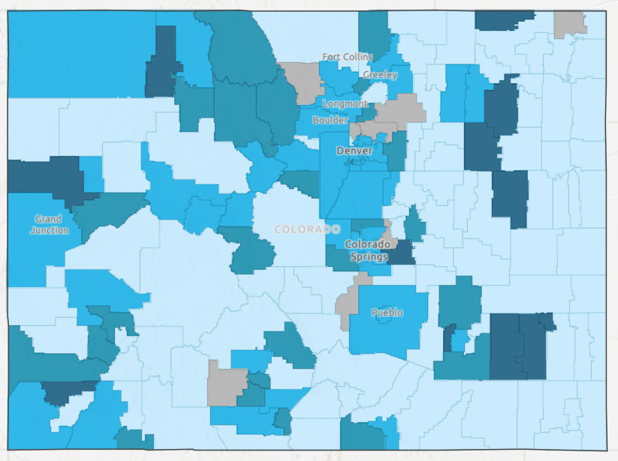
Session Materials
Notes:
Facilitation note: Please see Table 1 in Module 2 in the Facilitator’s Guide for an outline of all the materials needed for the session for both in-person and virtual facilitation. Update this slide to reflect the specific materials depending on the mode of facilitation.
For this session, we will use the Colorado GIS map application. We’ll go into greater detail on the map shortly. Second, we’ll use the module workbook to help guide our work together today.

Slide 36
Introduction to the
Colorado Educator Workforce Pipeline GIS Map
Notes:
Facilitation note: Slides 37-48 are covered in the video introduction (https://youtu.be/UUl_SG18Jnc). You may request participants watch the video as pre-work to the session or play the video in lieu of the slides.
First, we’re going to introduce you to the Colorado Educator Workforce Pipeline GIS map.

Slide 37

Why GIS? Place Matters
(Dreier et al., 2014; Orfield, 2011; Sampson, 2012; Sharkey, 2013)
Notes:
Where a person lives, learns, and works can have a dramatic impact on the outcome of their life. These “place effects” are the result of unequal access to resources and opportunities (Dreier et al., 2014; Orfield, 2011; Sampson, 2012; Sharkey, 2013). In your own community, you may be aware of a part of town that is divided by a road or some other border. The people who live on the other side of the road may have less access to health care services and grocery stores; the homes may be valued less; and the schools have fewer resources. You could imagine that the students in these communities face additional challenges outside of the school walls that may be impacting their learning.
These place effects can also apply in the context of educator shortages. Educators, like most people, want to work in positive environments. For example, they may want to work close to where they live, have a good salary, and have high-quality school leadership. There are systems that may also be impacting educator shortages and contribute to these place effects. For example, there may not be educator preparation programs nearby to supply new teachers to a school or there may be more competitive job opportunities nearby.
A GIS application will allow us to see and help unpack these place effects.

Slide 38

Geographic Information System
GIS software uses maps as a container for multiple layers of data.
Notes:
Geographic Information Systems allows us to take multiple sources of data from multiple sources and visualize data on a map. It can help us see that access to high-quality educators looks different for different students in different communities.

Slide 39
How does GIS work?
Notes:
How does GIS work? Let’s talk about some basics to help understand the application before you use it yourself.

Slide 40
How does GIS work?
Lines
Points
Polygons
GIS attaches data to geographic shapes.
Notes:
First, let’s introduces some GIS terminology. The first term is points. Points are unique locations that have an x value and a y value to define their location. This could include schools, businesses, historic sites. A line is a pair of points where one connects to the other and is often the natural boundaries in maps such as road, rivers, and railroads. And the last main term is polygons, an enclosed feature whose shape represents different kinds of data. It can also be thought of as an area. These are things like school districts, neighborhoods, and counties

Slide 41
Interstate 25
Notes:
Now let’s go through a set of examples to better help you understand what a point, line, or polygon is in an GIS application is. An Interstate is an example of a line.

Slide 42
Mesa County Valley School District 51
Notes:
A school district can be a bit tricky. If it is one building, it could be a point. However, often school districts represent a set of schools in which case it would be an example of a polygon.

Slide 43
Denver Center for International Studies at Montbello
Notes:
The Denver Center for International Studies would be a single point.

Slide 44
Greeley, Colorado
Notes:
Any given city is another tricky example. When the map is zoomed out looking at the entire state of Colorado, Greeley would be a point. When we zoom in, we would see it as a polygon representing an area that has a lot of subsections within it that we can break down further

Slide 45
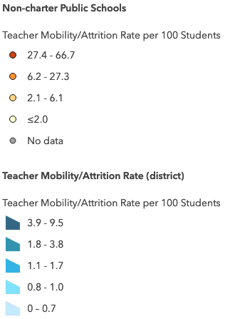
What are our options for visualization?
Notes:
Another important thing to understand about GIS is there are many options for how things can be visualized. There is various symbology that’s used to visualize components on the map. This can include different shapes, colors, shades on a scale, depth and dimension. The GIS application includes legends to help the user understand what the different shapes and colors represent. Here you also see the rates are scaled by number of teachers per 100 students making comparisons across schools and districts of different sizes easier.

Slide 46
How It Works
K12
Higher education
Labor
Social
Notes:
Now let’s go through an example so you can understand how an GIS application works. Let’s imagine we’ve taken Colorado’s school performance rating data and symbolized the school points based on their ratings for the 2019-20 school year. The red points represent schools who are on a Turnaround plan, the yellow points represent schools on a priority improvement plan, and the green points are schools on a performance plan. Overall, the school performance rating only tells us one small piece of the story.
Now looking to the squares on the right, they represent additional data we can add to the story. Let’s say we bring some economic data, health data, labor market data, and other social factor data such as the percentage of single mothers with school age children living in poverty.

Slide 47
How It Works
Notes:
Using GIS, we can layer these additional data sources that can help us begin to understand how these various factors come together for different communities. Now we can see the different challenges that are intersecting that may be impacting our lowest performing schools. This can help us better understand their challenges and work together across different agencies to address these challenges such as education and health collaborating.
GIS maps are an analytic tool that can focus administrative decision making and guide the types of cross-sectoral collaborations that are required to plan and implement systemic change efforts like strengthening the educator workforce pipeline. GIS helps us to understand the complexity of the state or regional environment so that we can convene the right people to take the right actions in the right places.

Slide 48
GIS Demonstration
Notes:
Facilitation note: You may give your own tour of how to navigate the GIS map or play the video (https://youtu.be/UUl_SG18Jnc) from 6:05.
Now let’s take you on a tour of the Colorado Educator Shortage GIS application.

Slide 49
1. Identify Key Findings Using the GIS Map
Notes:
Next, we’ll go over the process of identifying key findings using the GIS map. As we explore, analyze, and reflect on data displayed in the map, it’s important to keep in mind that we are exploring relationships, not causes, among these data. The map is a starting point that can be used to help facilitate dialogue and foster collaboration and partnership building among diverse groups of stakeholders (e.g., traditional and alternative educator preparation program leaders, including BOCES and other designated agencies; school district hiring managers and personnel directors; other entities working to strengthen the educator pipeline). Together, stakeholders can then engage in root cause analysis, identify strategies aligned to root causes using an equity-focused lens, and create and implement an action plan to test the effectiveness of their strategies in strengthening and diversifying the Colorado educator workforce.

Slide 50
Preview the Process to Review and Interpret Data
Findings: WHAT do the data say?
Data Interpretations: SO WHAT do the data mean?
Recommendations: NOW WHAT do we want to consider?
1
2
3
Notes:
There are three steps to exploring the data in the GIS map. The first step is to identify key findings or explore what do the data say. The second step is to look across the different findings and identify data interpretations. A data interpretation explores “so what” does the data mean. The third step is to create recommendations based on the findings and data interpretations or think about what we want to consider. This could be policy or practice recommendations based on the findings and data interpretations.
We’ll go into greater details on the first step and then identify findings from the GIS map.

Slide 51
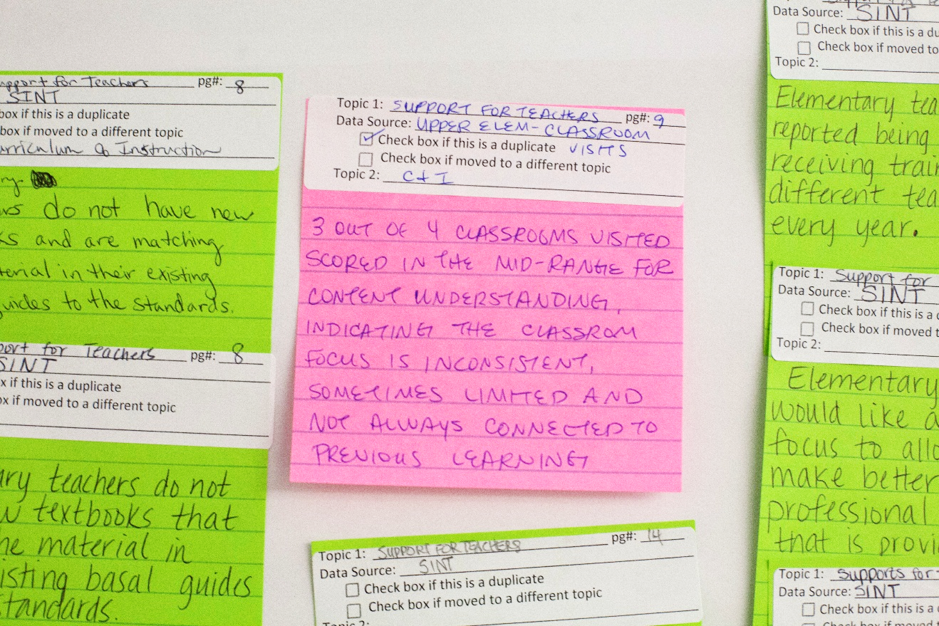
1. What is a finding?
A statement of information
A fact according to a report
A discovery
Quantitative or qualitative data
Notes:
What is a finding? A finding is a statement of information or a data point. It is a fact or a salient or significant discovery. Findings can be quantitative or qualitative data. Findings can state something that is going well or something that needs improvement. Findings are statements that reflect the data, not perspective solutions or questions. Findings are not interpretations or attempt to make meaning of the data.

Slide 52
Findings Are
Clear: Anyone could understand the meaning without further explanation.
Complete: Complete thought and sentence.
Specific: Refer directly to data.
Singular: One idea or finding per sticky note.
Notes:
When developing findings from the data in the GIS map, it is important that they are clear so anyone could understand their meaning without further explanation. The finding should be a complete thought and sentence. All findings refer directly to the data. We’ll be documenting our findings and should write one finding per sticky note.

Slide 53
Which is the best example of a finding?
Teachers tend to leave rural districts.
Vilas School District improved its teacher mobility and attrition rate by 14.90 teachers per 100 students over the last 5 years.
The majority of districts with the greatest teacher mobility and attrition are small and rural.
Notes:
Facilitation note: Ask participants to select which is the best example of the finding. If facilitating a virtual session, participants could submit their responses via a poll or chat box. If facilitating in-person, participants could be called on to answer.
Read through these three examples and select which one is the best example of a finding.
The second finding is the best example because it is a complete sentence, it is clear, and refers directly to the data. The third example could also be an example of a finding, but it is not the best example. The word “majority” could have different meaning to different people. This example could be strengthened by stating a specific number of districts or replacing majority by “almost all.”

Slide 54
1. WHAT do the data say?
Participants will be divided into [X] groups that will each focus on two essential questions and dashboards of the GIS map.
Groups will explore the data in the map.
Participants will identify findings from the GIS map.
Notes:
Facilitation note: Refer to pages 10-11 in the Facilitator’s Guide for further instructions on how to facilitate this discussion. Recommend assigning 3 to 5 participants per team.
Everyone will work in teams and will be assigned two essential questions or dashboard in the GIS map. Each group will explore the data in the map and identify key findings.

Slide 55
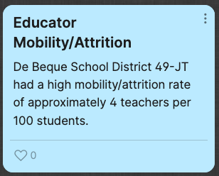
How to Complete a Sticky Note
Title: Dashboard name
Write or type something: Finding
Notes:
Facilitation note: Update the slide depending if you’re facilitating in-person or virtually.
Groups will document their key findings using sticky notes. At the top of your sticky note, write the name of your dashboard. For example, “Educator Mobility/Attrition” or “Labor Market.” Then in the body of the sticky note, write your findings. Remember that findings must be a complete sentence, clear, specific, and limit one finding per sticky note.

Slide 56
Group Roles
Notetaker: Write group’s key findings on sticky notes.
Reporter: Share one key finding from the group during share-out.
Navigator: Drives the GIS map by clicking the filters and pop-ups, and zooming in or out as guided by the group.
Notes:
Each group should assign someone to serve in three different roles. First, a notetaker who will write the group’s key findings on sticky notes. Second, a reporter who will share out one key finding from the group during the share-out. The final role is a navigator who will lead driving the GIS map by clicking on the different filters, pop-ups, and zooming the map. It is important the group provides feedback to each of these roles to capture the group’s perspectives.

Slide 57
Findings Share-Out
State dashboard name.
Share one key finding from the dashboard.
Repeat for each dashboard you reviewed.
Notes:
Each group will share out from their work. The reporter will share what was the essential question or dashboard that their group worked on and one key finding.

Slide 58
Break time, end of first session
Notes:
Facilitation note: Transition to a break or conclude first session, reminding audience when and where second session will be held.

Slide 59
2. Develop Data Interpretations
Notes:
Now that we’ve explored some key findings, we’ll go over the process for identifying data interpretations.

Slide 60
Preview the Process to Review and Interpret Data
Findings: WHAT do the data say?
Data Interpretations: SO WHAT do the data mean?
Recommendations: NOW WHAT do we want to consider?
1
2
3
Notes:
The next step in our process is to explore what the data mean. We’ll examine our findings and begin to develop data interpretations.

Slide 61
2. Data Interpretations
Read what colleagues wrote for their findings.
Reflect on what do the data mean. Are there themes or trends across the different findings?
Group the findings together in the different themes.
Record data interpretations on individual sticky notes.
Notes:
To develop data interpretations, first we’ll read through all the findings. Next, we’ll reflect on the findings and consider if there are any themes, patterns, or trends across the different findings. Based on those themes or trends, group the different findings together. For example, you may have different findings that focus on equity issues or findings that highlight financial constraints. Then looking at each group of findings, record your data interpretation on a new sticky note.

Slide 62
How to Group Findings
Findings can be grouped by themes that can be based on:
  Topic (e.g., equity, finances)
  Region or entity (e.g., school, district, educator preparation program)
  Role (e.g., teacher, principal, special service provider)
The purpose of grouping the findings is to identify patterns or trends across the findings and to make meaning as to why they are occurring.
Notes:
To group your findings, first consider themes across the different findings. For example, the findings can be groups by themes that are based on specific topics such as issues related to equity or financial challenges. Another approach to grouping findings is based on a specific region or entity such as findings by specific schools or school-levels, districts, or preparation programs. You could also group findings by specific roles such as teacher or principal. You may apply the same finding to multiple theme groupings. The purpose of grouping the findings by themes is to help identify patterns or trends across the findings and then to develop a hypothesis or make meaning as to why we’re seeing this trends in the data.

Slide 63
Examples of Developing Data Interpretations From Findings
Example 1
Finding | Districts with the highest teacher mobility and attrition rates do not have TLCC survey data.
Data Interpretation | The working conditions in these schools may be so challenging they are unable to obtain high enough response rates to have TLCC scores.
Example 2
Finding 1 | Districts and schools along the I-70 corridor experience more unfilled educator positions.
Finding 2 | The median income in districts along the I-70 corridor is over $65,000.
Data Interpretation | Districts and schools along the I-70 corridor may experience challenges recruiting educators due to the cost of living and nearby competitive employers.
Notes:
A data interpretation is a hypothesis as to why a pattern in the data is occurring. The groups are making meaning of what they see in the data. The data interpretation should connect to the data identified in the findings and used the group’s contextual knowledge of what is going on in the district or region in Colorado. You may develop one data interpretation based on one finding or multiple findings.
Here are some examples of a data interpretation developed from one finding and another example based on two findings. You may develop multiple data interpretations from the same set of findings. For example, in the first example on this slide, another data interpretation you could add is that “the working conditions in these schools may be so challenging that teachers do not feel comfortable or safe responding to the TLCC survey.”

Slide 64
Group Roles
Notetaker: Write the group’s data interpretations on sticky notes or chart paper.
Notes:
Facilitation note: Update the slide depending if you’re facilitating in-person or virtually.
We’ll break out into the same groups to develop data interpretations. Each group will be assigned one to two themes. Select a new person to serve as the notetaker.

Slide 65
3. Create Recommendations
Notes:
Next, we’ll go over the process for identifying creating recommendations.

Slide 66
Preview the Process to Review and Interpret Data
Findings: WHAT do the data say?
Data Interpretations: SO WHAT do the data mean?
Recommendations: NOW WHAT do we want to consider?
1
2
3
Notes:
Our final step in this process is to create recommendations. Based on our findings and data interpretations, what do we want to consider for next steps to strengthen the educator workforce pipeline.

Slide 67
3. Recommendations: NOW WHAT do we want to consider?
Brainstorm potential strategies or recommendations to address the educator workforce pipeline challenge or opportunity.
Note the recommendations on a sticky note.
Notes:
After developing data interpretations for all the findings, we’ll write recommendations or considerations. For each data interpretation, brainstorm potential strategies or recommendations to address the educator workforce pipeline challenge or opportunity. Note each consideration on a stick note.

Slide 68
How to Develop a Recommendation
Take each data interpretation and brainstorm possible strategies to address what was uncovered.
The recommendation could be:
  A priority area (e.g., improving working conditions or supporting educator recruitment in rural areas)
  A specific strategy to implement (e.g., grow-your-own program or hiring protocol)
  Needed research or additional data to explore
  Resources or opportunities to leverage
Notes:
To develop a recommendation, brainstorm possible strategies, policies, or practices that could address the challenge or opportunity uncovered for each data interpretation. The recommendation could focus on an area to prioritize within the educator pipeline such as improving working conditions or supporting recruitment efforts in rural areas. The recommendation may focus on a specific strategy to implement that will address the challenges such as developing a grow-your-own program or creating a new hiring protocol. There may be an area that will require further research or additional data and that could be the recommendation in order to explore the issue further.

Slide 69
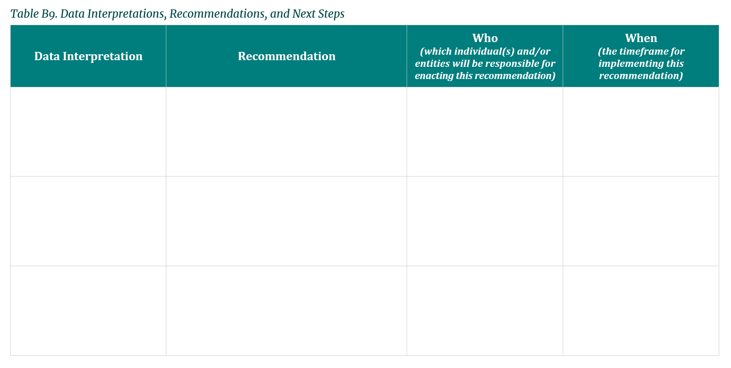
Capturing Recommendations
Notes:
Facilitation note: Refer to pages 12-14 in the Facilitator’s Guide for further instructions on how to facilitate this discussion. Update this slide if facilitating in-person versus virtually.
In your workbook on Table B9, each group will document write their data interpretations and create the corresponding recommendation. It is possible to have multiple recommendations for one data interpretation. Once you’ve finished developing the recommendations, consider who will be responsible for enacting this recommendation and note this on the “who” column. This could be specific individual or individuals or entities. Finally, consider a specific timeline for implementing the recommendation on the last column. This could be categorizing recommendations by short and long-term or adding a specific time period.

Slide 70
Group Roles
Notetaker: Write the group’s recommendations in the workbook.
Reporter: Share recommendations from the group during share-out.
Notes:
We’ll break out into the same groups to create recommendations. You may assign different people to serve as the reporter and notetaker.

Slide 71
Recommendations Share-Out
Share one of your group’s recommendations and corresponding data interpretations.
Are there any recommendations others would add?
Notes:
Each group will share their recommendations and corresponding data interpretations. After each group presents, the other groups will have an opportunity to add any additional recommendations or feedback to the list of recommendations.

Slide 72
References for Methodology
Dreier, P., Mollenkopf, J., & Swanstrom, T. (2014). Place matters. Metropolitics for twenty-first century. University Press of Kansas.
Orfield, M. (2011). American metropolitics: The new suburban reality. Brookings Institution Press.
Sampson, R. (2012). Great American city: Chicago and the enduring neighborhood effect. University of Chicago Press.
Sharkey, P. (2013). Stuck in place: Urban neighborhoods and the end of progress toward racial equality. The University of Chicago Press.
Notes:
The is a list of references supporting the study of unequal access to resources and opportunities through the consideration and exploration of place effects.

Slide 74
Module 3:
Root Cause Analysis

Slide 75
Welcome and Introductions
Notes:
Facilitation note: Welcome audience and segue to facilitator introductions on next slide. If desired, individual participant introductions can also be included.

Slide 76
Facilitators
[Insert name(s) of facilitator(s)]
Notes:
Facilitation note: Update this slide with the name(s) of your facilitator(s). Introduce yourself including your background and experience related to the educator workforce.

Slide 77
Today’s Objectives
Identify barriers and challenges to addressing educator shortages and diversifying the workforce.
Categorize barriers and challenges to inform planning and next steps (e.g., developing action plans that will address educator shortages and diversify the workforce).
Identify root causes of educator shortages and diversity gaps.
Notes:
During today’s session, we’ll identify barriers and challenges to addressing educator shortages and diversifying the workforce by reflecting on the data from the previous session. Next, we’ll categorize the challenges and identify root causes.

Slide 78
Norms for Discussion
Be present and attentive.
Share the air.
Respect what is shared.
Notes:
**Suggestions for norms. Update with your own norms or discussion guidelines.**
For our work to be productive and positive, we have some norms for our discussion together. First, we ask that everyone be present and attentive. Please minimize other distractions so you can be fully present and participate in the session. The next norm is to share the air. Please contribute freely to the discussion while also providing time for others to do so. The works benefits from hearing from all your diverse perspectives as we explore the root causes. Finally, we ask that everyone respect what is shared. Are there any other norms you would like to add?

Slide 79
Strengthening the Colorado Educator Workforce Pipeline Modules
Module 1: Landscape Analysis
Module 2: Data Analysis
Module 3: Root Cause Analysis
Module 4: Select Strategies
Module 5: Action Planning
Notes:
This session is the third of a five modules designed to help district or regional teams use data to identify community specific strategies to strengthen and diversify the educator workforce. In the first module, teams reflected on existing and past efforts to prepare, recruit, and retain diverse educators by conducting a landscape analysis. The second module guided teams in analyzing local data using a geographic information system map. In this module, teams will reflect on the data findings from the previous module and determine the root causes of their educator workforce challenges. For the fourth module, teams will explore new and existing strategies to address the root causes identified and determine which will be the best fit for their local needs and capacity. For the final module, teams will develop an action plan to implement the identified strategies to strengthen and diversify the educator workforce.

Slide 80
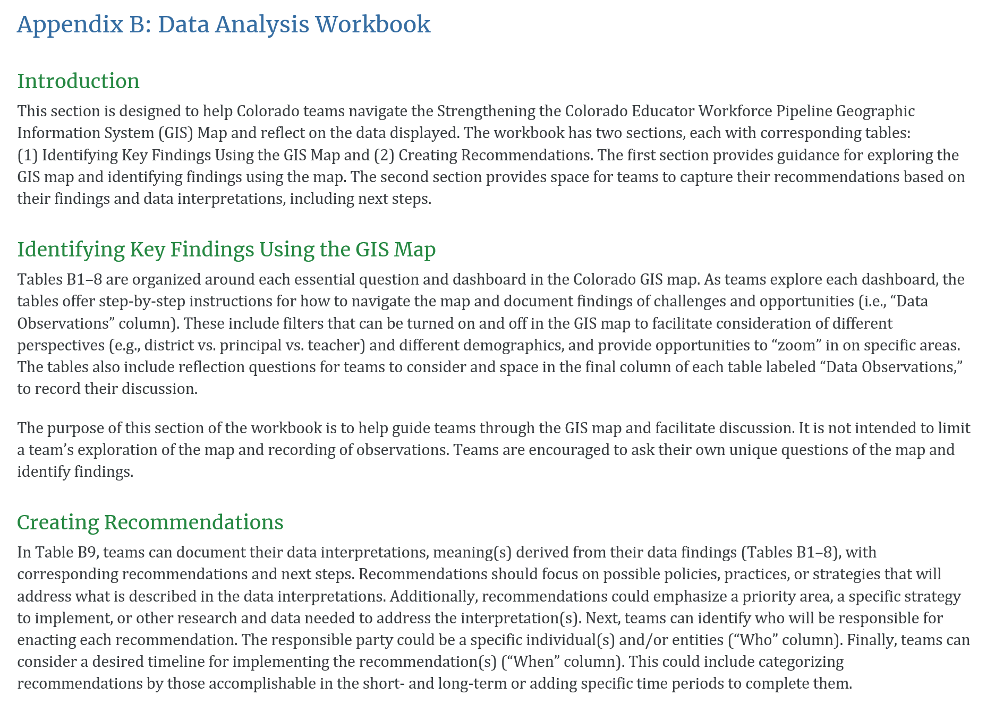
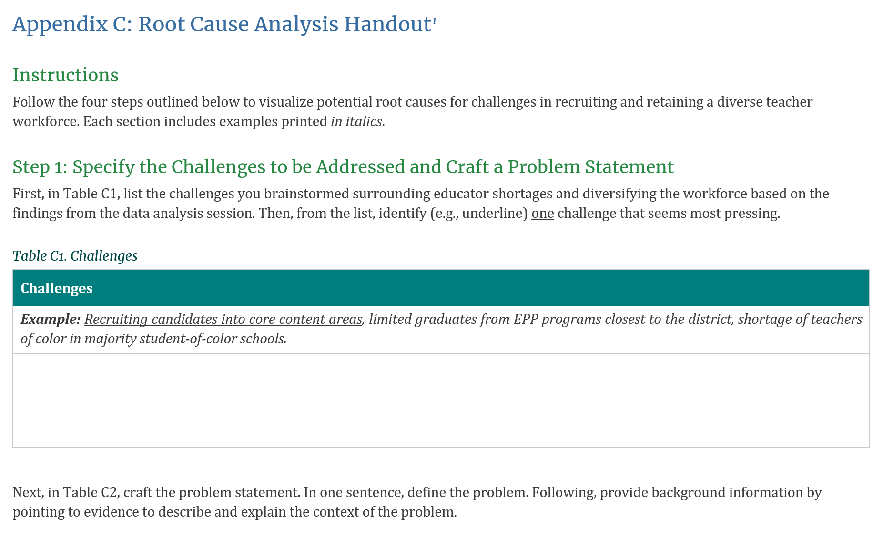
Session Materials
Notes:
Facilitation note: Please see Table 1 in Module 3 in the Facilitator’s Guide for an outline of all the materials needed for the session for both in-person and virtual facilitation. Update this slide to reflect the specific materials depending on the mode of facilitation.
For this session, we’ll use the workbook that was completed during the data analysis session and use a new handout for the root cause analysis.

Slide 81
Review Data Analysis

Slide 82
Review Data
Individually, review data analysis workbook.
With a partner, discuss interesting data findings or data interpretations.
Share out a reflection from the data analysis process.
Notes:
Before reflecting on the root causes to our challenges with educator shortages and diversity gaps, it is important to review the data analysis from the previous session. First, on your own, review the workbook we completed previously.
Next, with a partner, discuss any data findings or data interpretations that stood out to you. Finally, let’s have one or two groups share out a reflection from the data analysis process.

Slide 83
Root Cause Analysis

Slide 84
Purpose of Root Cause Analysis
Unearth the root causes or issues contributing to educator shortages and diversity gaps.
Make an effective claim or case for addressing these issues by clearly identifying the causes of a problem to anyone who is not part of the process.
Identify comprehensive talent development solutions.
Notes:
What is the purpose of a root cause analysis? A root cause analysis is a systematic process for identifying the deepest underlying cause or causes of a problem. Addressing the root causes, rather than addressing obvious symptoms, enables stakeholders to permanently address a challenge. A root cause analysis is not a single methodology but, rather, is composed of many tools, processes, protocols, and perspectives. The root cause analysis will help us target comprehensive talent development solutions to the sources of the challenges.

Slide 85
Steps in the Process
Step 1
Specify the challenges to be addressed and craft a problem statement
Step 2
Identify root causes
Step 3
Categorize root causes
Step 4
Explore Root Causes (5 Whys)
(Center on Great Teachers and Leader, 2014 & 2017)
Notes:
We’ll provide an overview of the four steps for a root cause analysis. We’ll go in greater detail on each of these steps in the next few slides. First, we’ll refer to the data analysis from the previous session and identify the challenges highlighted in the data. Then, we’ll craft a problem statement. In the second step, we’ll brainstorm potential root causes to the challenges identified. In the third step, we’ll categorizes the causes and finally explore the root causes by completing the 5 whys in the fourth step.

Slide 86



Step 1: Specify the Challenges and Craft a Problem Statement
Reflect individually on the educator shortages and the diversifying the workforce challenges.
As a team, brainstorm a list of challenges.
Write them down.
As a team, identify the one challenge that seems to the most pressing.
Right now, discuss only one.
Reference the Landscape Analysis and consider findings and reflections from the Data Analysis session.
Notes:
Refer to your data findings and interpretations from the previous module. First, reflect individually on the challenges surrounding educator shortages and diversifying the educator workforce based on the data. Next, as a team, brainstorm a list of challenges and document those in Table C1 of the handout. As a team, identify one challenge that seems most pressing. Refer to your data from the pervious session to help guide your decision.

Slide 87
Step 1: Specify the Challenges and Craft a Problem Statement
Problem
  Using one sentence, define the problem.
Background
  Use evidence to describe and explain the context of the problem.
Example
The diversity of the teacher workforce in our district does not match the diversity of the student population (46 percent gap between teachers and students of color). There is a 22 percent gap between African American students and teachers and a 14 percent gap between Latinx students and teachers.
Notes:
Next, craft a problem statement from your identified challenge. The problem statement should define the problem in one sentence and use evidence form the data to explain the context of the problem. The blue box on the slide provides the following example, “The diversity of the teacher workforce in our district does not match the diversity of the student population (46 percent between teachers and students of color). There is a 22 percent gap between African American students and teachers and a 14 percent gap between Latinx students and teachers.” This problem statement identifies the problem of the lack of diversity of the educator workforce and specifies the context by using data to describe the difference between students and teachers. Write your problem statement in Table C2 of the handout.

Slide 88

Step 2: Identify Root Causes
Brainstorm the root causes of the challenge identified in Step 1.
These are the reasons why the challenge may be occurring.
Notes:
For the second step, brainstorm potential root causes or reasons for the identified problem from the first step. In our previous example, our problem statement was focused on diversifying the educator workforce. For this challenge, some causes could be that students of color have negative school experiences, district practices don’t recruit Black or Latinx teachers, or incentives and pay are not attractive enough. Write your ideas for root causes in the table of the step 2 section of your handout.

Slide 89

Step 3: Categorize Root Causes
Look back at the root causes identified in Step 2.
  Consider how you can group the causes into categories.
  List those categories.
This Photo by Unknown Author is licensed under CC BY-SA-NC
Notes:
For the third step, categorize the possible root causes from the second step. First, consider how to group the causes into categories. If there is a root cause that does not fit into a category, it can remain as its own category. For the previous example focused on diversifying the educator workforce, some categories of the root causes could be less desirable teaching and learning conditions, limited support or resources, or low levels of community. Write your categories in Table C4 of the handout.

Slide 90
Step 4: Explore Root Causes (5 Whys)
 | RCA Example
Root Cause Category | Lack of diversity in educator workforce
Why 1? | District has issues recruiting diverse teachers
Why 2 (about Why 1)? | EPP programs have issues recruiting diverse students into their prep programs
Why 3 (about Why 2)? | Students are negatively affected by biases in schools, which discourages them from becoming teachers
Why 4 (about Why 3)? | School curriculum is not culturally responsive and doesn’t encourage cross-cultural communication and understanding
Why 5 (about Why 4)? | Many legislators and policymakers are stuck in a “we’ve always done it this way” frame of thinking
Potential Solution/s | Using research to demonstrate effectiveness of culturally-responsive curriculum and instruction to policymakers and stakeholders, offer incentives to recruit diverse educators into EPP programs and the profession
List root cause category.
Identify up to 5 responses to the question “Why is this the case?”
Try to dig deeper and explore why these problems happen.
Notes:
The final step of the root cause analysis is to complete the “5 whys.” For each of your root cause categories, discuss as a team “why is this the case?” As a team, identify up to five responses to “why is this case?” each digging deeper than the previous why. The example on the slide shows an example for the challenge of a lack of diversity in the educator workforce. The first why identifies that the district has issues recruiting diverse teachers. Why is this the case? The second why answers that educator preparation programs also have issues recruiting diverse students into their programs. If preparation programs’ graduates lack diversity, then that could explain why districts are unable to recruit diverse teachers. The third why digs deeper and explains why preparation programs struggle to recruit diverse teacher candidates is because students are negatively affected by biases in schools, which discourages them from becoming teachers. Why is this case? The fourth why states that it is because school curriculum is not culturally responsive and doesn’t encourage cross-cultural communication and understanding. Why is the curriculum not culturally responsive? The fifth why explains that many legislators and policymakers are stuck in a “we’ve always done it this way” frame of thinking.
This process helps teams dig deeper to the root causes of the challenges to help district leaders identify potential solutions that will target the source of the challenge. Complete the “5 Whys” table in the Step 4 section of the handout.

Slide 91

Reflections
What trends or patterns do you see in your root causes?
Where along the Talent Development Framework continuum (e.g., attract, prepare, or retain) do your root causes fall?
(Center on Great Teachers and Leaders, 2020)
Notes:
Now that you’ve finished all four steps of the root cause analysis, discuss and reflect on the following questions. First, what trends or patterns do you see in your root causes? For example, are there common systems identified such as the legislature or needs such as professional learning. Next, determine where along the Talent Development Framework (pictured here on the slide) do your root causes fall? Are most of your root causes from the 5 whys related to attracting educators to the profession or do they focus on the need to prepare more educators.

Slide 92
Next Steps

Slide 93
Strengthening the Colorado Educator Workforce Pipeline Modules
Module 1: Landscape Analysis
Module 2: Data Analysis
Module 3: Root Cause Analysis
Module 4: Select Strategies
Module 5: Action Planning
Notes:
The next step in our process is to select strategies to address the root causes identified. We will cover this in our next session focused on module 4.

Slide 94
References
Center on Great Teachers and Leaders. (2020). Talent development framework: Improving access to excellent educators for all students. American Institutes for Research. https://gtlcenter.org/sites/default/files/Talent_Dev_Framework_06_16_20.pdf
Center on Great Teachers and Leaders. (2017). Moving toward equity root-cause analysis workbook: A guide for state education agencies. American Institutes for Research. https://gtlcenter.org/sites/default/files/GTL_Root-CauseAnalysisWorkbook-ed.docx
Center on Great Teachers and Leaders. (2014). Resource 7: Engaging stakeholders in a root-cause analysis. American Institutes for Research. http://www.gtlcenter.org/resource_7

Slide 96
Module 4:
Select Strategies

Slide 97
Welcome and Introductions
Notes:
Facilitation note: Welcome audience and segue to facilitator introductions on next slide. If desired, individual participant introductions can also be included.

Slide 98
Facilitators
[Insert name(s) of facilitator(s)]
Notes:
Facilitation note: Update this slide with the name(s) of your facilitator(s). Introduce yourself including your background and experience related to the educator workforce.

Slide 99
Today’s Objectives
Identify the category of strategies that will address your root causes.
Explore new strategies and reflect on existing strategies.
Determine the appropriate strategy to address each root cause based on local context.
Notes:
During today’s session, we’ll identify the category of strategies that will address the root causes you found in the previous session. Next, we’ll explore new strategies by reviewing example programs, initiatives, or policies and reflect on our current existing strategies. Finally, we’ll determine the appropriate strategies to address the root causes based on your local context.

Slide 100
Norms for Discussion
Be present and attentive.
Share the air.
Respect what is shared.
Notes:
**Suggestions for norms. Update with your own norms or discussion guidelines.**
For our work to be productive and positive, we have some norms for our discussion together. First, we ask that everyone be present and attentive. Please minimize other distractions so you can be fully present and participate in the session. The next norm is to share the air. Please contribute freely to the discussion while also providing time for others to do so. The works benefits from hearing from all your diverse perspectives as we explore the root causes. Finally, we ask that everyone respect what is shared. Are there any other norms you would like to add?

Slide 101
Strengthening the Colorado Educator Workforce Pipeline Modules
Module 1: Landscape Analysis
Module 2: Data Analysis
Module 3: Root Cause Analysis
Module 4: Select Strategies
Module 5: Action Planning
Notes:
This is the fourth session of five modules designed to help district or regional teams use data to identify community specific strategies to strengthen and diversify the educator workforce. In the first module, teams reflected on existing and past efforts to prepare, recruit, and retain diverse educators by conducting a landscape analysis. The second module guided teams in analyzing local data using a geographic information system map. In the third module, teams determined the root causes of their educator workforce challenges. For this module, teams will explore new and existing strategies to address the root causes identified and determine which will be the best fit for their local needs and capacity. For the final module, teams will develop an action plan to implement the identified strategies to strengthen and diversify the educator workforce.

Slide 102
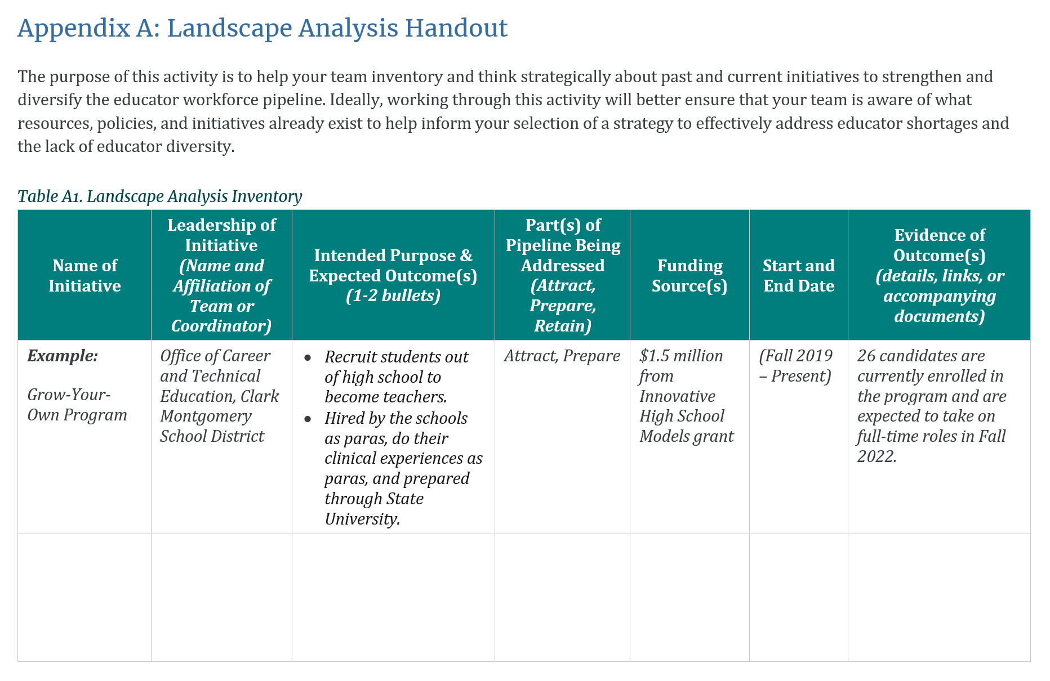
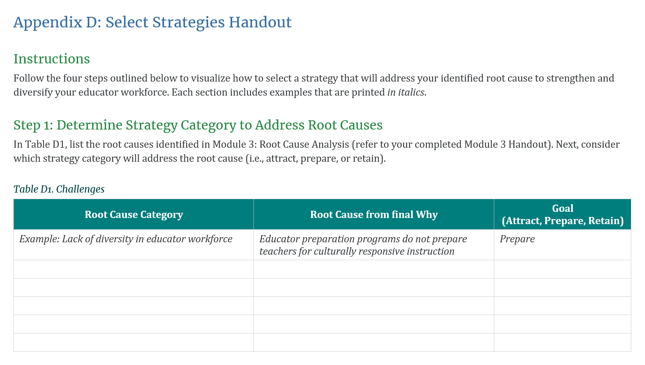
Session Materials
Notes:
Facilitation note: Please see Table 1 in Module 4 in the Facilitator’s Guide for an outline of all the materials needed for the session for both in-person and virtual facilitation. Update this slide to reflect the specific materials depending on the mode of facilitation.
For this session, we’ll reference the landscape analysis handout we completed in first session and the root cause analysis handout from the previous session. We will also use a new handout to select strategies and the online shortage selection tool.

Slide 103
Select Strategies

Slide 104

Reflections on Pre-Work
Share one interesting strategy from the pre-reading.
(Guiden & Giffin, 2021)
Notes:
Facilitation note: Prior to the session, provide this paper highlighting different strategies from Colorado districts and schools. It is available at https://region12cc.org/wp-content/uploads/2021/11/Colorado-Bright-Spots_508.pdf.
Prior to this session, we had asked you to read the paper Addressing Educator Workforce Shortages: Colorado Bright Spots. What was one interesting strategy from the pre-reading?

Slide 105
Steps in the Process
Step 1
Determine goals for strategies to address root causes
Step 2
Explore strategies and consider local context
Step 3
Review initiatives identified during your landscape analysis
Step 4
Select strategies/initiatives
Notes:
There are four steps in the process to select appropriate strategies to address each root cause identified in the previous module. In the first step, we list the root causes we identified from the “Five Whys” activity from the previous session and determine the strategy category that will address each root cause. Next, we will explore strategies and reflect on examples from other states, districts, and educator preparation programs. Next, we’ll revisit our landscape analysis from the first session of module 1 and reflect on whether there are any existing efforts that with some refinements could address our root causes. Finally, we will select our strategies.

Slide 106
Step 1. Determine Goals for Strategies to Address Root Causes
Root Cause Category | Root Cause from final Why | Goal (Attract, Prepare, Retain)
Declining enrollment in educator preparation programs | Negative perceptions of the teaching profession | Attract
Notes:
In Table D1 of the select strategies handout, document your root causes from the “Five Whys” activity from the previous session. Next, consider which overall goal(s)—attract, prepare, retain‚—for the strategies will address the root causes. In the example on the slides, the root cause category from the “Five Whys” was declining enrollment in educator preparation programs. The final why from the root cause analysis for this root cause category is the negative perceptions of the teaching profession. For this example, the goal is to “attract,” since the negative perceptions of the teaching profession is making it difficult to attract talent.

Slide 107

Step 2. Explore Strategies and Consider Local Context
Read 1 to 3 examples from the Shortage Selection Tool
Respond to the following reflection questions:
  What are the strengths of the example strategy?
  What are some challenges with the example?
  What are some considerations to apply this to your local context?
(CEEDAR Center, n.d.)
Notes:
Facilitation note: For this step, the team will use the online Shortage Strategy Selection Tool. A link to the tool is included as part of Step 2 in handout for this session and is also available at https://ceedar.education.ufl.edu/gtl-selection-home/.
For the second step, the team will explore and read through up to three example strategies from the Shortage Selection Tool developed by the Center on Great Teachers and Leaders (GTL Center) and the Collaborative for Effective Educator Development, Accountability, and Reform (CEEDAR) and the pre-reading. Select strategies and examples based on the goals you identified from step one that aligns with your root cause. For each example, discuss and reflect on the following questions: 1) what are the strengths of the example strategy; 2) what are some challenges with the example; and 3) what are some considerations to apply to your local context.

Slide 108
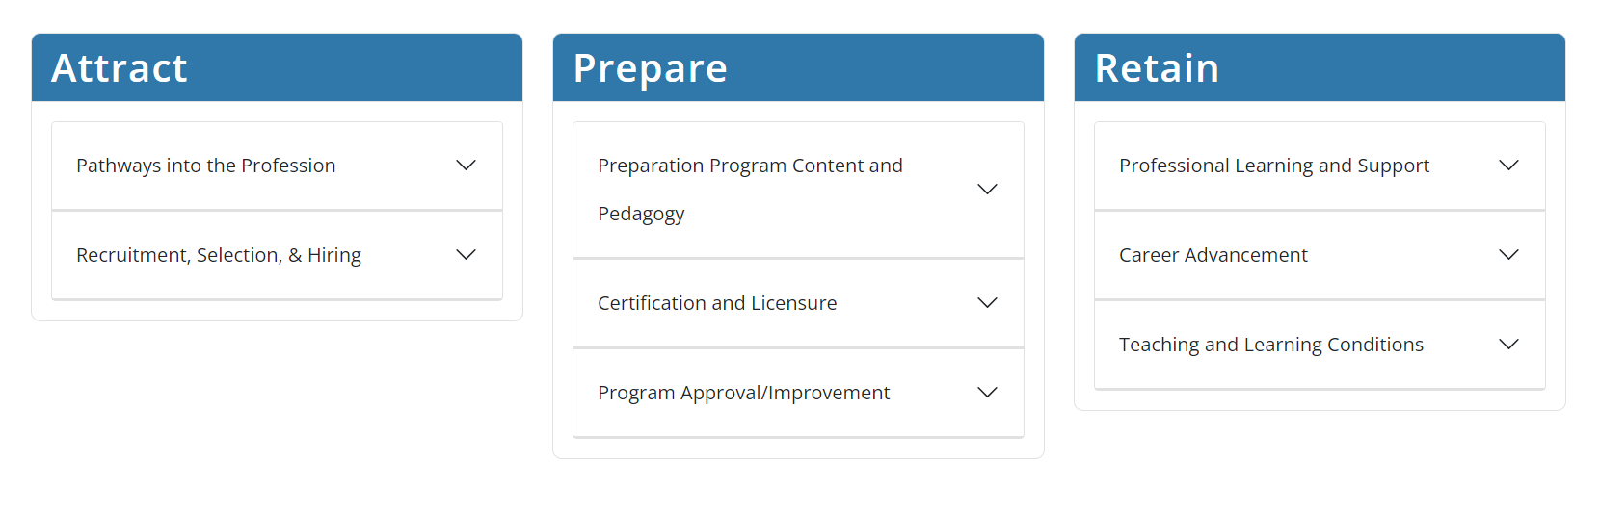
Navigating the Shortage Selection Tool
(CEEDAR Center, n.d.)
Notes:
Facilitation note: For this step, the team will use the online Shortage Strategy Selection Tool. A link to the tool is included as part of Step 2 in handout for this session and is also available at https://ceedar.education.ufl.edu/gtl-selection-home/.
I will now demonstrate how to navigate the Shortage Selection Tool. Near the bottom of the page there are three boxes labeled “attract,” “prepare,” and “retain.” Choose the box that matches with your goal based on your root cause. In our example from the previous step, we’re focused on the “prepare” box to address that root cause that educator preparation programs do not prepare teachers for culturally responsive instruction. Click the arrows to the drop-down menu to extend the list of strategies under each topic in the prepare box.

Slide 109
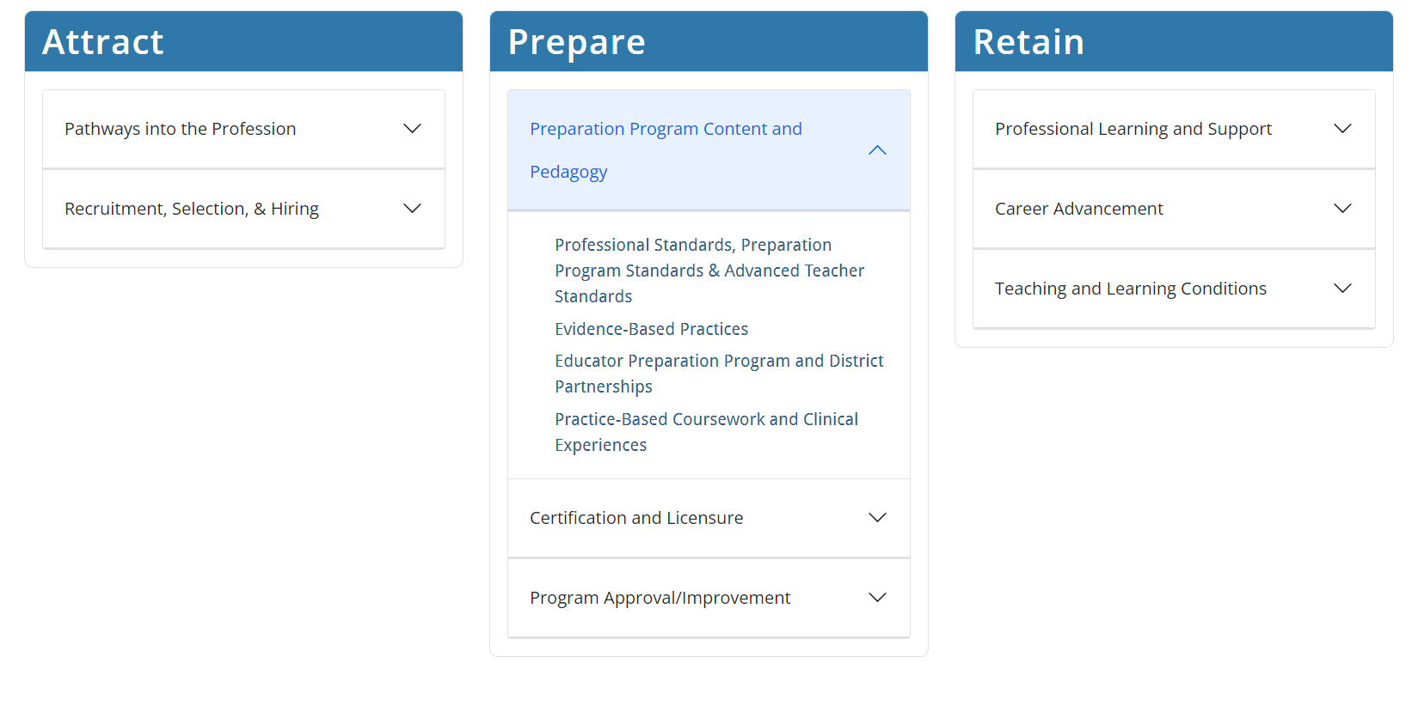
Navigating the Shortage Selection Tool
(CEEDAR Center, n.d.)
Notes:
Once I click the arrow, I see a list of links for different strategies that fit under “preparation program content and pedagogy.” For example, the list of strategies include professional standards, preparation program standards, and advance teacher standards; evidence-based practices; educator preparation program and district partnerships; and practice-based coursework and clinical experiences. Let’s say I want to see some examples of practice-based coursework and clinical experiences to see if there are any examples that are culturally responsive. I will click that link.

Slide 110
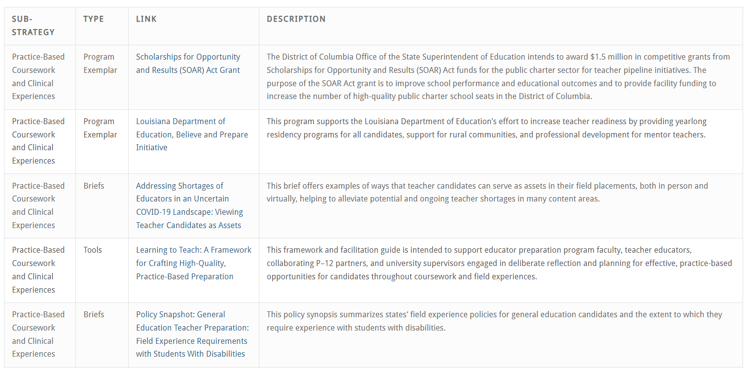
Navigating the Shortage Selection Tool
(CEEDAR Center, n.d.)
Notes:
Once you click the link, the page will take you to a table with descriptions to resources and example programs related to the sub-strategy. You can click the link to the resource or program to learn more. For this activity, we want to you review up to three examples strategies that align to your goal and could potentially address your root cause. You will then discuss and reflect on how to apply the example in your context.

Slide 111
Step 2 Example
Goal | Strategy and sub-strategy | Name of resource or link | What are the strengths of the example strategy? | What are some challenges with the example? | What are some considerations to apply this your local context?
Retain | Teaching and Learning Conditions; Diversity Equity & Inclusion | Culturally and Linguistically Diverse Students: What EPPs Need to Do to Support Teacher Learning | Revisions to courses including adding a new course on intensive English learners (EL) and language-acquisition strategies Requiring clinical experience to include practice-based tutoring with ELs | Will require buy-in from university leadership Additional resources | Does not address all needs around culturally responsive instruction
Notes:
Here is an example of what to complete in Table D2 of your handout. In this example, the goal is retain, the strategy is “Teaching and Learning Conditions,” the sub-strategy is “Diversity, Equity and Inclusion,” and the title of the example resource explored is “culturally and linguistically diverse students: What EPPs Need to do to Support Teacher Learning.” After reviewing this resource, we identified some strengths of the example such adding a course on intensive EL and language-acquisition strategies and requiring clinical experiences to include practice-based tutoring for English language learners. For some of the challenges with implementing this program to our local context could be building the buy-in needed from leadership and the additional resources required. For the final column, discuss what needs to be considered to apply this example program to your local context. For example, this program does not address all the needs around culturally responsive instruction.

Slide 112
Step 3. Review Initiatives Identified During Module 1: Landscape Analysis
Consider if there are any existing initiatives or efforts that aim to address your root cause.
Reflect on guiding questions to determine if you should expand or continuously improve efforts.
  What outcomes did this effort achieve?
  What changes could you make to continuously improve the effort to address the root cause?
  What resources would you need?
Notes:
Now that you’ve explored some strategies and examples, we want to reflect on our existing programs and initiatives. There may be initiatives already underway that are having positive outcomes for strengthening the educator workforce or efforts that could better address the root causes of educator shortages with some refinements in implementation. For step three, review the landscape analysis you completed in the first session during module 1. Consider if there are any existing initiatives or efforts that aim to address your root cause. Note those initiatives in Table D3 of your handout and discuss the guiding questions to consider if you should continuously improve or expand any efforts. Discuss what outcomes the effort achieved, what changes need to be made to continuously improve the effort to address the root cause, and what resources may be needed. Write your reflections in Table D3 of your handout.

Slide 113
Step 3 Example
Goal | Strategy from Landscape Analysis | What outcomes did this effort achieve? | What changes could you make to continuously improve the effort to address the root cause? | What resources would you need?
Prepare | Professional Learning Community for faculty focused on diversity, equity, and inclusion | Positive feedback from faculty surveys on increased knowledge of DEI practices | Expand efforts to replicate PLC with teacher candidates | Staff/faculty to facilitate Efforts to promote
Notes:
This slide illustrates an example for the third step. In this example, the team reflected on an existing program from their landscape analysis of a professional learning community for educator preparation faculty focused on diversity, equity, and inclusion. This could support addressing our root cause of educator preparation programs do not prepare teachers for culturally responsive instruction. For the outcomes of this program, the team found positive feedback surveys that indicated participating faculty increased their knowledge of DEI practices. For what changes could be make to continuously improve the effort to address the root cause, this example suggests expanding the program to replicate a similar PLC with teacher candidates so they could further build their knowledge on DEI prior to entering classrooms. Finally, for additional resources, this example suggests that the PLCs will need someone to facilitate and promote efforts.

Slide 114
Step 4. Select Strategies
Select your top three strategies/ initiatives
Consider initiatives from landscape analysis and example strategies you explored
Strategies and/or initiatives will be the focus on the team action plan
Notes:
For the final step, we will now prioritize our list of strategies or initiatives that will address the root causes identified. Based on the example strategies explored and the initiatives from the landscape analysis, select your top three strategies/initiatives. These will be the focus on the team’s action plan that will be developed in the next session. Write your strategies/initiatives in Table D4 of your handout.

Slide 115
Next Steps

Slide 116
Strengthening the Colorado Educator Workforce Pipeline Modules
Module 1: Landscape Analysis
Module 2: Data Analysis
Module 3: Root Cause Analysis
Module 4: Select Strategies
Module 5: Action Planning
Notes:
The next step in our process is to develop an action plan based on our selected strategies. We will cover this in our next session in module 5.

Slide 117
References
Collaborative for Effective Educator Development, Accountability, and Reform Center. (n.d.) Shortage strategy selection tool. https://ceedar.education.ufl.edu/gtl-selection-home/
Guiden, A., & Giffin, J. (2021). Addressing educator workforce shortages: Colorado bright spots. Region 12 Comprehensive Center. https://region12cc.org/wp-content/uploads/2021/11/Colorado-Bright-Spots_508.pdf

Slide 119
Module 5:
Action Planning

Slide 120
Welcome and Introductions
Notes:
Facilitation note: Welcome audience and segue to facilitator introductions on next slide. If desired, individual participant introductions can also be included.

Slide 121
Facilitators
[Insert name(s) of facilitator(s)]
Notes:
Facilitation note: Update this slide with the name(s) of your facilitator(s). Introduce yourself including your background and experience related to the educator workforce.

Slide 122
Today’s Objectives
Explore potential tasks to implement the strategy(ies) based on your role.
Develop an action plan to implement the strategy(ies).
Notes:
Facilitation note: Update this slide depending on if your team identified one strategy or multiple strategies from the previous module.

Slide 123
Norms for Discussion
Be present and attentive.
Share the air.
Respect what is shared.
Notes:
**Suggestions for norms. Update with your own norms or discussion guidelines.**
For our work to be productive and positive, we have some norms for our discussion together. First, we ask that everyone be present and attentive. Please minimize other distractions so you can be fully present and participate in the session. The next norm is to share the air. Please contribute freely to the discussion while also providing time for others to do so. The works benefits from hearing from all your diverse perspectives as we explore the data. Finally, we ask that everyone respect what is shared. Are there any other norms you would like to add?

Slide 124
Strengthening the Colorado Educator Workforce Pipeline Modules
Module 1: Landscape Analysis
Module 2: Data Analysis
Module 3: Root Cause Analysis
Module 4: Select Strategies
Module 5: Action Planning
Notes:
This session is the final of a five modules designed to help district or regional teams use data to identify community specific strategies to strengthen and diversify the educator workforce. In the first module, teams reflected on existing and past efforts to prepare, recruit, and retain diverse educators by conducting a landscape analysis. The second module guided teams in analyzing local data using a geographic information system map. In the third module, teams reflected on the data findings and determined the root causes of their educator workforce challenges. For the fourth module, teams explored new and existing strategies to address the root causes identified and determined which will be the best fit for their local needs and capacity. For the final module, teams will develop an action plan to implement the identified strategies to strengthen and diversify the educator workforce.

Slide 125
Session Materials
Shortage Strategy Selection Tool
Notes:
Facilitation note: Please see Table 1 in Module 5 of the Facilitator’s Guide for an outline of all the materials needed for the session for both in-person and virtual facilitation. Update this slide to reflect the specific materials depending on the mode of facilitation.
For this session, we will use the Action Planning Workbook to help guide our work. We will also use the Shortage Strategy Selection Tool (https://ceedar.education.ufl.edu/gtl-selection-home/) You may also want to review your completed workbooks from the previous sessions.

Slide 126
Action Planning

Slide 127
Steps in the Process
Step 1
Explore tasks by role
Step 2
Develop an action plan
Notes:
There are two steps to the action planning process. The first step is to explore and discuss a list of potential tasks for our selected strategy(ies). Next, we’ll develop an action plan based on our long-term goals and reflections from the potential tasks discussed during the first step.

Slide 128
Step 1. Explore Tasks by Role
For our strategy and team member roles, review the potential tasks from the Shortage Strategy Selection Tool’s Role Guides
Respond to the following reflection questions:
  What are the strengths of the example tasks?
  What are some challenges with the example tasks?
  What are some considerations to apply this to your local context?
  Which tasks should you include in your action plan?
(CEEDAR Center, n.d.)
Notes:
Facilitation note: For this step, the team will use the online Shortage Strategy Selection Tool. The link is available in the workbook and is available at https://ceedar.education.ufl.edu/gtl-selection-home/.
For our strategy(ies), read the Role Guide from the Shortage Strategy Selection Tool. There are three Role Guides for each of strategy category of attract, prepare, and retain. In the Role Guide, there is a list of tasks to implement each strategy for state education agencies, educator preparation programs, and school districts. Discuss and respond to the reflection questions in the workbook for the potential tasks for our identified strategy(ies) and team roles.

Slide 129
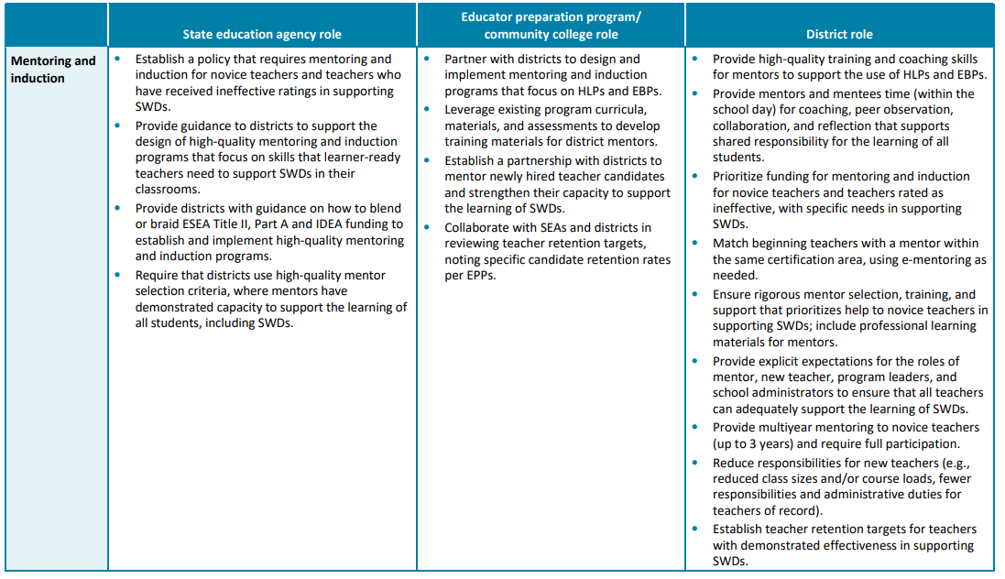
Strategies Role Guide
(CEEDAR Center, n.d.)
Notes:
Facilitation note: For this step, the team will use the online Shortage Strategy Selection Tool. The link is available in the workbook and is available at https://ceedar.education.ufl.edu/gtl-selection-home/.
On the slide is an example from the Role Guide for the strategy of mentoring and induction. It includes tasks and considerations for implementing mentoring and induction programs for different roles. For example, educator preparation programs may have a role to support the curriculum of mentoring and induction programs. Districts have different potential tasks such as providing time within a school day for mentors and mentees to meet for coaching.

Slide 130
Step 2. Develop an Action Plan
Determine your team’s short-term and long-term goals for implementing the strategy(ies), keeping in mind your root cause(s).
Outline the tasks to implement the strategy(ies).
Consider your reflections on tasks from the role guide.
For each task, identify a person responsible and timeline.
Notes:
In the second step, we’ll determine our long-term and short-term goals for implementing each strategy. It is important to keep in mind the root cause were aiming to address with this strategy. Once we’ve established our goals, outline the necessary tasks to implement the strategy within your local context. Refer to your reflections from step 1 from the role guide. For each task, identify someone who will be responsible for the task’s completion and a timeline.

Slide 131
Reflection
Reflect on and discuss the barriers to successful implementation of the strategy(ies) that may exist.
What is needed to overcome the barriers?
Notes:
Once the team has completed the action plan, reflect and discuss as a whole group what are the potential barriers to successfully implementing the strategy(ies). Next, discuss what is needed to overcome the identified barriers.

Slide 132
References
Collaborative for Effective Educator Development, Accountability, and Reform Center. (n.d.) Shortage strategy selection tool. https://ceedar.education.ufl.edu/gtl-selection-home/

